Slide 1
How to give a
Handover!
GREAT
By Caleb Fellowes
Nursing student at the university of Newcastle

Slide 2
Content
Reasons for the presentation
The objectives of the presentation
What is handover?
Where can handover be conducted
What should and shouldn’t be said during handover
Examples of good and poor handover
What should be done if you receive
a poor handover

Slide 3
Why do I need to learn about handover?
Although Handover is one of the national standards it has been observed that the handover process still needs improvement.
When correct and timely information is passed onto the receiving health care professional, the patient is able to receive appropriate care.
Patient safety is at risk when information is not provided to the staff taking over the patients care.
(Pascoe, Gill, Hughes & McCall-white, 2014)

Slide 4
What is the objective of this presentation
To improve health care professionals understanding of an appropriate handover by providing information on how to structure a good handover
To provide health care professionals with knowledge on how to phrase handover which is appropriate and unbiased
To provide knowledge as to where handover can be conducted
All objectives will be addressed during the presentation and will be assessed by reflective questions at the end of the presentation.

Slide 5
What is handover?

Slide 6
Handover is the transfer of information as well as professional responsibility of a patient to another professional.
It is important because health care professionals need to be well informed of all patients in their care.
Handover has no one way to be done which can make it a risk for patient safety as they can be unreliable and cause adverse events due to information not being accurately passed on. This is why it has become a national standard and will be accredited on how facilities standardise their handover.
(Iedema, 2014)

Slide 7
Where should handover be done?

Slide 8
There are places handover can be done
Bedside- this is the most widely used place for handover because the patient can be involved although it can make maintaining full confidentiality hard.
Or in a room only staff can enter- this maintains confidentiality but the nurse is unable to visualise the patient they are receiving. This should only be done at shift change over or when handing over to a multidisciplinary team member.
(Tollefson, 2012) (safety and quality improvement guide, 2012)

Slide 9
What do I need to say in a handover?
Patients name and age
Why the patient is in hospital
What has been done for the patient and the responses to the treatment
If there are and devices attached to the patient e.g. IVs
Physical assessment, vitals and any pain
If there has been bloods taken or tests and if the results are back
The plan for the patient
Any consults completed or requested
If the patient has assistance with ADLs or special needs
And discharge planning if started
(Tollefson, 2012) (Levett-Jones & Bourgeosis, 2012)

Slide 10
what do I need to say continued…
Always refer to the patient by their name not what they are being treated for.
Make sure the patient was already aware of the information being handed over and that it is relevant to the situation
Ask the patient if they would like to add anything
Also allow the other nurse time to ask questions
Make sure there is adequate time allowed for handover

Slide 11
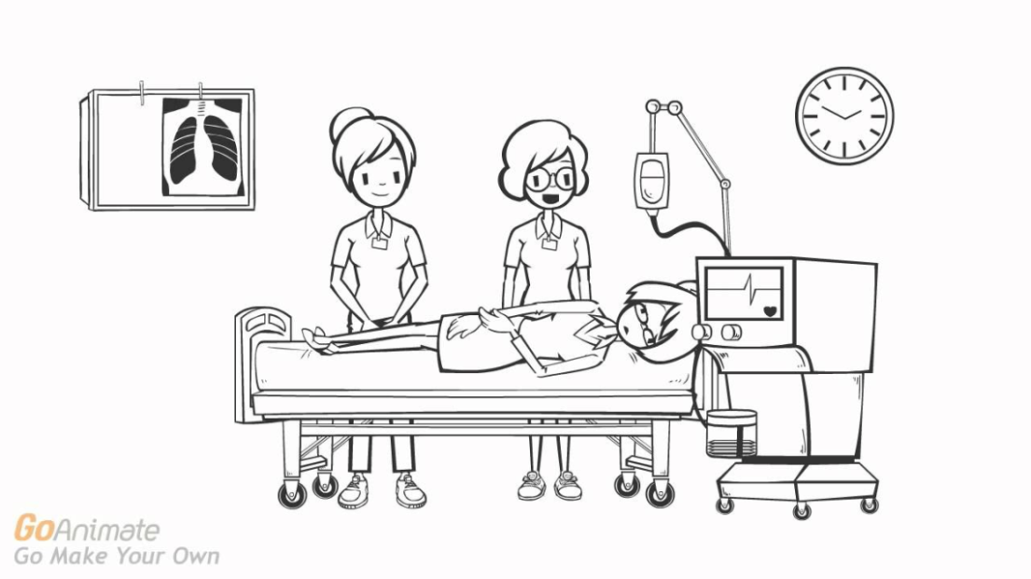
Example of a good handover
Fig 1
Fig 2
https://www.youtube.com/watch?v=hbxPR-ra6
RE
Fig 3

Slide 12
Example of a poor handover
Fig 4
https://www.youtube.com/watch?v=cMlwh1OpxLU
Fig 5

Slide 13
What are the
Adverse events can occur due to information being missed.
Priority assessment could be missed as it hasn’t been stated if they have already been done or not
Information may be given which may be misleading to what the priority issue is.
distractions
Of a poor handover
(Loseby, Hudson &Lyon, 2013)

Slide 14
Ask questions!!!!
Look at the documentation
Ask another staff member who was involved in the patients care
(Tollefson,2012)

Slide 15
If handover in continuously not up to standards may need to inform staff member on tips that could help their handover or make the in-charge aware if situation continues.

Slide 16
Identify patient
Reason for admission
What has been done, what needs to be done
Recent assessments
Treatment attended and response to the treatment
Any test results that need follow up
Discharge information
Summary points

Slide 17
Reflection Questions
1. what is handover?
2. where should I do my handover?
3. what do I need to say?

Slide 18
References
Australian commission on safety and quality in health care.(2012). Standard 6 clinical handover: safety and quality improvement guide. Retrieved from: http://www.safetyandquality.gov.au/wp-content/uploads/2012/10/Standard6_Oct_2012_WEB.pdf
Iedema, R.(2014). Clinical handover. In T. Levett-Jones, (Eds.), critical conversations for patient safety: an essential guide for health professionals(pp. 62-72). Frenchs Forest, N.S.W.:Pearson Australia.
Levett-Jones,T.,& Bourgeois,S.(2012). The clinical placement: an essential guide for nursing students (2ed.) Chatswood, N.S.W.: Elsevier Australia
Loseby,J., Hudson,A.,&Lyon,R.(2013),clinical handover for the trauma and medical patient: a structured approach. Journal of paramedic practice, 5(10), 563-567, retrieved from: http://eds.b.ebscohost.com.ezproxy.newcastle.edu.au/eds/pdfviewer/pdfviewer?sid=16b59845-8791-4f00-aa30-f435b456fbd6%40sessionmgr111&vid=2&hid=114
Pascoe,H., Gill,S.D., Hughes,A.& McCall-white,M.(2014), clinical handover: an audit from Australia. Australasian medical journal, 7(9), 363-371, retrieved from: http://eds.b.ebscohost.com.ezproxy.newcastle.edu.au/eds/pdfviewer/pdfviewer?sid=e801f99d-77df-41a1-b03c-fceff378f8aa%40sessionmgr113&vid=2&hid=114
Tollefson, J.(2012). Clinical psychomotor skills: assessment skills for nurses. (5ed.). South Melbourne V.I.C.:cengage learning Australia

Slide 19
Picture references
Fig 1 retrieved from http://www.stmichaelshospital.com/media/detail.php?source=hospital_news/2013/20131120_hn
Fig 2 retrieved from https://www.youtube.com/watch?v=kXAeYe7i52o
Fig 3 retrieved from http://wikieducator.org/PVG_Culture_Change_in_Handover:_Quick_Need_Survey
Fig 4 retrieved from http://angelabrook.com/burnout-affects-more-than-just-your-nurses
Fig 5 retrieved from http://www.nursingtimes.net/whats-new-in-nursing/management/the-big-issues-in-nursing/5001025.article
Video references
Video 1-https://www.youtube.com/watch?v=hbxPR-ra6
Video 2-https://www.youtube.com/watch?v=cMlwh1OpxLU

