Slide 1
ALS Drug Therapy
Hunter New England Local Health District
Advanced Life Support Committee
Updated May 2016

Slide 2
Drug Administration
Intravenous Route
IV drug administration is preferable
Large bore cannula
If no visible peripheral veins evident, consider the external jugular
Avoid lower limbs (impairment of venous return)
Fluid flush of 20-30mL & external cardiac compressions
Avoid repeated unsuccessful attempts at cannulation, not > 90 seconds  IO route

Slide 3
Drug Administration
Intraosseous (IO) Route
Safe and effective for fluid resuscitation, drug delivery and laboratory evaluation
Attainable in all age groups
“valuable time should not be wasted (more than 90 seconds) with repeated unsuccessful attempts at cannulation because alternative access to the circulation is possible via the bone marrow intraosseous route”
(ANZCOR Guideline 11.5 2016)

Slide 4
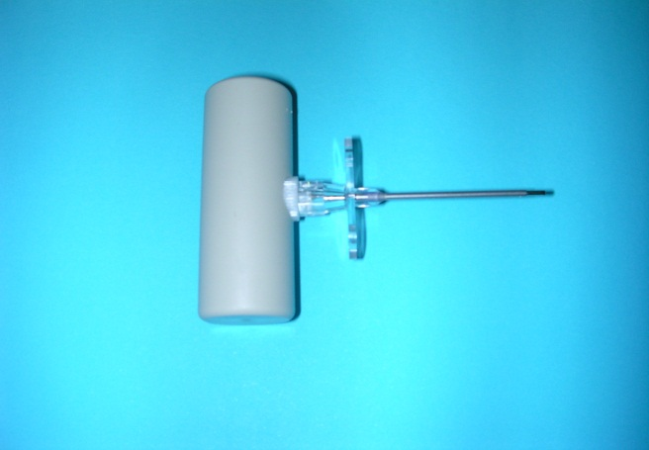
Intraosseous (IO) Route
Relatively safe, simple, rapid and therapeutically successful technique for the provision of emergency fluids to the critically ill child or adult
Can be utilised until standard or conventional venous access can be obtained.
Not recommended for use > 24 hr period.

Slide 5
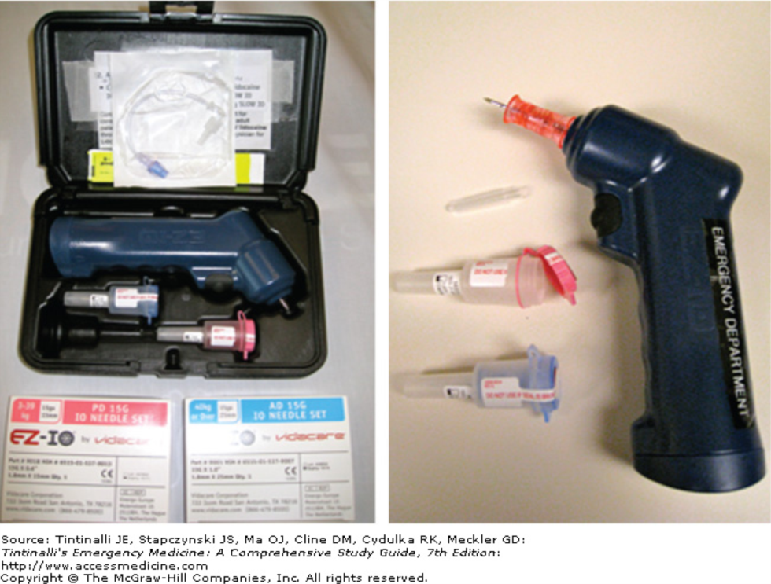
The Intraosseous (IO) Gun
Tintinalli's Emergency Medicine: A Comprehensive Study Guide,
Resuscitative Procedures, Section 4
7e, 2011
Date of download: 8/19/2014
Copyright © 2014 McGraw-Hill Education. All rights reserved.

Slide 6
Intraosseous (IO) Route
All intravenous fluids and drugs can be administered IO
Drug and fluid doses and rates are the same as for conventional vascular route.
All fluids and drugs must be administered with the aid of pressure or injected from a syringe.

Slide 7
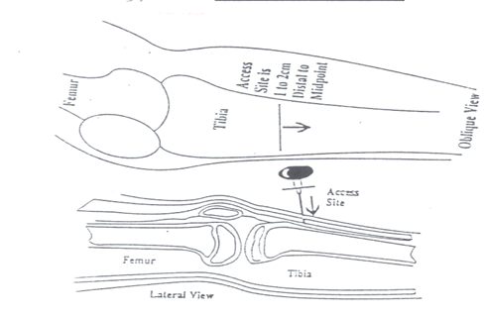
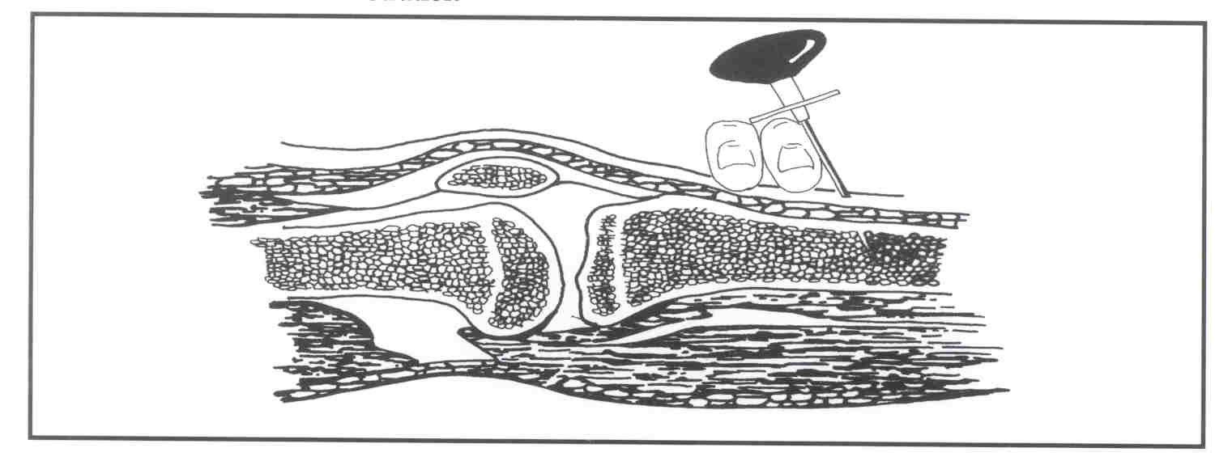
IO Sites
Proximal Tibia
Optimal site in children - broad flat surface with a thin layer of skin covering the bone.
Cortex is easy to penetrate and marrow content abundant.
Used up the age of 5-6 years – after this age the proximal tibia becomes much thicker and harder to penetrate.
Preferred site of insertion is the anteromedial surface of the tibia, approximately 2-3cm below the tibial tuberosity.

Slide 8
IO Alternative Sites
Alternative sites include:
Distal tibia
Distal femur
Iliac crests

Slide 9
IO Insertion Technique
Palpate tibial tuberosity
Insert IO needle 1-2cm below this point, perpendicular to the leg, with slight angle toward the foot to avoid epiphyseal plate.
A boring action is used until a decrease in resistance or ‘pop’ is felt, indicating entry to the marrow.
The needle should then stand on it’s own and should not be inserted any further to avoid the needle penetrating through the other side of the bone. The distance of insertion is rarely greater than 1cm.
Notes:
The epiphyseal plate contains cartilage which is replaced by bone (until maturity).

Slide 10
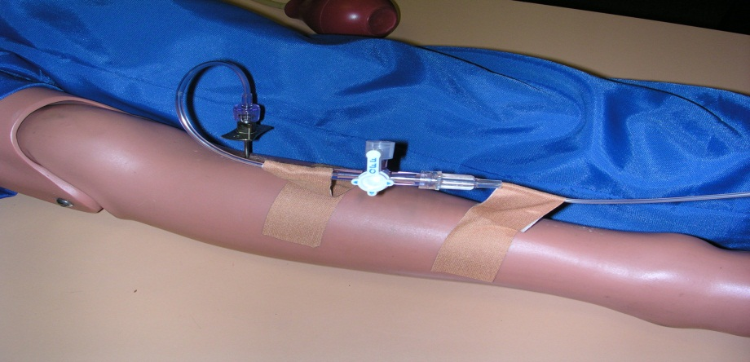
IO Insertion Technique
5. Aspirate bone marrow to confirm placement, then flush.
6. Anchor the IV line on the leg as shown.
Notes:
Prior to point 5, remove the needle after insertion and keep device stabilised.

Slide 11
IO Contraindications
Bone disease, e.g. osteogenesis imperfecta.
Infection or potential for infection over lying the insertion site, e.g. cellulitis, burns.
Fracture of the bone or where previous attempts of intraosseous insertions have taken place, into the same bone.
Vascular injuries – prevent reliable venous outflow.

Slide 12
Pharmacological Intervention
“No medication has been
shown to improve long term survival in humans
after cardiac arrest.
Priorities are defibrillation, oxygenation and
ventilation together with external cardiac compression”
(ANZCOR Guideline 11.5, 2016)

Slide 13
Resuscitation Drugs
Specific Resuscitation Drugs | Other drugs to be considered to manage particular condition's in cardiac arrest
Adrenaline | Magnesium
Amiodarone | Potassium
 | Lignocaine (may be used as an alternative to Amiodarone) Calcium Sodium Bicarbonate
Vasopressin can be used in settings that do not use Adrenaline
(ARC Policy Guideline 11.6 February 2006)

Slide 14
Specific Resuscitation Drugs

Slide 15
Adrenaline
Actions:
A naturally occurring catecholamine with alpha & beta effects.
In cardiac arrest via its alpha adrenergic action it produces peripheral vasoconstriction
Directs available cardiac output to the myocardium and brain
Indications:
VF / Pulseless VT that have not responded to initial defibrillation attempts
Asystole and PEA (EMD) as initial treatment.

Slide 16
Adrenaline
Adverse Effects:
Tachyarrhythmia's
Severe hypertension after resuscitation
Tissue necrosis if extravasation occurs
Adult dosage:
1mg every 4 minutes (2 loops during CPR)
Paediatric dosage:
10 mcg/kg IV/IO dose every 4 minutes during CPR (0.1mls/kg for 1:10,000)
Notes:
Adrenaline is a nurse-initiated drug for a cardiac arrest as per policy HNELHD POL 12_05 (ALS by credentialed Registered Nurses)

Slide 17
Amiodarone
Action:
Antiarrhythmic drug with complex pharmacokinetics and pharmacodynamics. Has effects on Na+, K+ and C- channels, as well as alpha and beta-adrenergic blocking properties.
Indications:
Failure of DC shocks and adrenaline to revert VF/Pulseless VT (given between third and fourth shock )
Prophylaxis of recurrent VF/VT.
In children – atrial tachycardia's, SVT, pulseless VT, junctional ectopic tachycardia.

Slide 18
Amiodarone
Adverse Effects:
Hypotension
Bradycardia
Heart block
Adult dosage:
Initial bolus dose is 300mg (in dextrose).
An additional 150mg could be considered
Followed by an infusion (15mg/kg over 24 hrs)
Paediatric dosage:
Initial bolus is 5mg/kg (may be repeated)

Slide 19
Vasopressin
Action:
Commonly referred to as an antidiuretic hormone. In high doses vasopressin acts as a non-adrenergic peripheral vasoconstrictor and therefore is an effective vasopressor.
Indications:
Vasopressin is an alternative vasopressor to adrenaline, meta-analysis trials show that vasopressin offers no advantages compared to adrenaline (ARC Guideline 12.4 pg2 Dec 2010).
Dose:
Adult - bolus of 40 units IV (20 pressor units/mL)
Paediatric – approximately 0.5 - 0.8U/kg IV/IO

Slide 20
Other Drugs to be considered to help manage particular conditions with patients who have arrested

Slide 21
Magnesium
Action:
Magnesium is an electrolyte essential for membrane stability.
Indications:
Torsade de pointes
Cardiac arrest associated with digoxin toxicity
Documented hypokalemia
Documented hypomagnesium
VF/pulseless VT (usually administered when refractory to defibrillator shooks and vasopressor)
.

Slide 22
Magnesium
Adverse Effects:
Excessive use may lead to muscle weakness and respiratory failure.
Adult dosage:
5mmol bolus, which may be repeated once and followed by an infusion of 20mmol over four hours.
5mmol can be given as 2.5mL of 50% magnesium sulphate (1mL = 2mmol Mg ions = 500mg magnesium sulphate), or 5mL of 20% magnesium chloride (1mL = 1 mmol Mg ions = 200mg magnesium chloride).

Slide 23
Magnesium
Paediatric dosage:
Bolus dose 0.1-0.2mmol/kg followed by an infusion of 0.3mmol/kg over 4 hours

Slide 24
Potassium
Action:
Potassium is an electrolyte essential for membrane stability.
Low serum potassium, especially in conjunction with digoxin therapy and hypomagnesaemia, may lead to life threatening ventricular arrhythmias.
Indication:
Persistent VF due to documented or suspected hypokalaemia

Slide 25
Lignocaine
Action
Lignocaine acts as a sodium channel blocker.
Indications
VF/pulseless VT as an alternative to Amiodarone
Prophylaxis in the setting of recurrent VF or VT
Dosage
1mg/KG bolus. During resuscitation an additional bolus of 0.5 mg/kg may be considered. It is not recommend to commence a lignocaine infusion until return of spontaneous circulation

Slide 26
Calcium
Action:
Essential for normal muscle & nerve activity.
Transiently increases myocardial excitability and contractility & peripheral resistance.
Not routinely administered in a cardiac arrest.
Indications:
Hyperkalaemia
Hypocalcaemia
Overdose of calcium-channel blocking drugs.

Slide 27
Calcium
Adverse Effects:
Possible increase in myocardial & cerebral injury by mediating cell death.
Tissue necrosis with extravasation
Adult dosage:
5-10mL of 10% Calcium Chloride
10mL of 10% Calcium Chloride = 6.8mmols Ca ions = 360mg elemental calcium.
Alternative formulation: Calcium Gluconate
10mL of 10% calcium Gluconate = 2.2mmols Ca ions.
Paediatric dosage:
IV/Intraosseous 0.2mL/kg of 10% Calcium Chloride or approximately 0.7mL/kg of 10% Calcium Gluconate (20mg/kg) (ARC Guideline 12.4 2010).

Slide 28
Sodium Bicarbonate (and other buffers)
Early effective BLS measures and adequate ventilation negate the need for NaHCO3, Four studies reported bicarbonate use was associated with poor short and long term outcome (ARC Guideline 11.5 2010).
Action:
Sodium bicarbonate is an alkalising solution, which combines with hydrogen ions to form a weak acid, carbonic acid. This breaks down to produce CO2 and H20.
In most cardiac arrests early efficient CPR and adequate ventilation negate the need for any NaHCO3.
Indications:
Hyperkalaemia
Treatment of documented metabolic acidosis
Overdose with tricyclic antidepressants
Protracted arrest (greater than 15 minutes)

Slide 29
Other Drugs / Fluids
Intravenous Fluids
Evidence neither supports or refutes routine use of fluids.
Should be infused if hypovolaemia is suspected (20mL/kg).
Thrombolytics
Should be considered in adult patients with cardiac arrest with proven or suspected pulmonary embolism.

Slide 30
Glucose
The normal level is 3-8mmol/L
Adult dosage:
20-50mL (50%) slow IV (3mL/min)
Hypoglycaemia may be present in paediatric critical illness, particularly in infants.
Paediatric dosage:
0.5mL/kg of 50% Dextrose (CVC only) or 2.5mL/kg of 10% Dextrose slow IV/IO (Guideline 12.4 ARC 2010)

Slide 31
Paediatric Dosages
Drugs | Indications | Drug Dosage
Adrenaline | VF, VT, PEA, Asystole | 10mcg/kg IV/IO (0.1mL/kg of 1:10 000)
Amiodarone | VF, VT, SVT, Atrial Tachycardias | 5mg/kg bolus
Atropine | Severe Bradycardia | 20 mcg/kg IV or IO
Glucose | Hypoglycaemia | 2.5mls/kg of Dextrose 10% IV/IO 5-8mg/kg/min (maintenance)
0.9% Normal Saline | Hypovolaemia, fluid resuscitation | 20mls/kg bolus
Adenosine | SVT (consider ice or valsalva 1st) | First Dose = 0.1mg/kg (max 6mg) Second Dose = 0.2mg/kg (max 12mg)

Slide 32
Questions ?

