Slide 1
Cytotoxic Medication Management Workshop
Lia Heffernan
Clinical Nurse Educator
Medical & Interventional Services
Updated 2016

Slide 2
Aims of the workshop
Understand the principles of Cytotoxic medication administration
Personal Protective Equipment (PPE)
Staff Safety/Surveillance
Waste Management
Cytotoxic Pharmacology
Spills Management
Linen Management
Local Clinical Procedures
Accreditation

Slide 3
PRINCIPLES OF CYTOTOXIC MEDICATION ADMINISTRATION

Slide 4
Is it different?

Slide 5
You still are required to administer in a safe manner.
How do we ensure this?
Right person
Right medication
Right dose & frequency
Right time
Right route
Right documentation
….and check allergies and reactions
Notes:
It should be noted that new IV pumps (challenge pumps )
These are not compatible with delivering cytotoxic medication intravenously. Baxter pumps will still be required for the administration of IV cytotoxic medications.
The risk of loss integrity with the delivery sets for the challenge pumps increases the risk of exposure and the creation of a cytotoxic spill.

Slide 6
There are additional precautions that need to be understood

Slide 7
What are cytotoxic medications?
Cytotoxic drugs work by causing the death of certain types of cells
Cytotoxic drugs are used to treat conditions such as cancer, rheumatoid arthritis, multiple sclerosis and some ophthalmic conditions
Cytotoxic drugs are known to be highly toxic to non-target cells, mainly through their action on cell reproduction

Slide 8
Classification
Mutagenic – capable of causing alterations or damage to the genes
Carcinogenic – capable of causing cancer
Teratogenic – capable of causing foetal defects, either anatomically or functionally

Slide 9
High Risk Medications
Have a high risk of causing harm or injury if there is misuse, or used in error
BEFORE administration, all high risk medications must have an independent double check of at least each element of the “rights of medication administration”:

Slide 10
What is an independent double check?
“Independent Double Check” means a procedure in which two clinicians separately check (alone and apart from each other, then compare results) each component of prescribing, dispensing, and verifying the high-alert medication before administering it to the patient.

Slide 11
High Risk Medications
Anti-infective agents
Potassium
Insulin
Narcotics
Chemotherapy
Heparin and other anticoagulants

Slide 12
Our local policy……as well as APINCH
High_Risk_Medicines_Management.pdf
All injectable drugs, including drugs given by IV, IM, subcutaneous and epidural routes
All injectable fluids, including IV infusions
Medications administered to patients under 18 years of age except where specifically exempted
Oral anticoagulants, includes warfarin

Slide 13
Our local policy……as well as APINCH
All accountable medications, (S4D and S8) including morphine, oxyCODONE, midazolam, Panadeine Forte®, temazepam, HYDROmorphone
Chemotherapeutic (cytotoxic) agents, includes oral agents supplied by pharmacy. Common examples are methotrexate and cyclophosphamide
Concentrated electrolytes, includes oral bowel cleansing solutions – Picolax®, ColonLYTELY®, Glycoprep®, PicoPrep®

Slide 14
STAFF SAFETY

Slide 15
Cytotoxic Medication will always be labelled
Notes:
Regardless of the route of delivery
This is the universal sign for Cytotoxic Medication and Management
Used as a warning and safety precaution.
The label prompts the user to use the universal ‘No Touch Technique’ when handling the medications

Slide 16
Occupational Exposure
Health effects that may be attributed to those who prepare and administer cytotoxic drugs:
Alterations to normal blood cell count
Foetal loss and possible malformation in offspring
Fertility changes
Abdominal pain, hair loss, nasal sores, vomiting
Liver damage
Contact dermatitis, local toxic or allergic reaction
“These effects have not been reported where a high standard of risk control is in place”

Slide 17
How can we be exposed?
Exposure may occur through:
Skin contact
Skin absorption
Inhalation of aerosols and drug particles
Ingestion
Sharps injuries

Slide 18
When can we be exposed?
Exposure may occur when:
preparing drugs
administering drugs
transporting drugs
handling patient waste
transporting and disposing of waste
cleaning spills
Notes:
Reminder that exposure can occur where control measures are not in place or adhered to

Slide 19
What the Research states
Little scientific evidence to suggest that working with cytotoxic increases the risk of developing cancer
Little is known about long-term effects from occupational exposure
The most significant risk is during the manufacture and preparation of cytotoxic drugs
Significant risk is present when handling cytotoxic drugs and related waste
Pregnancy –risk minimisation
Notes:
In the absence of data Workcover indicate that prudent avoidance is recommended (1)
There are no exposure limits (2)
Medical opinion suggests that even low-level exposure should be avoided (2)
Suitable safety precautions minimises the incidence of adverse health outcomes (2)
To protect the health of employees the first priority is to eliminate or minimise the risks to health (4)
Pregnant, breast feeding or planning parenthood should have substantial confidence that risks are minimised, but have the right to elect not to participate in such cases and appropriate/suitable alternative duties must be provided (5)

Slide 20
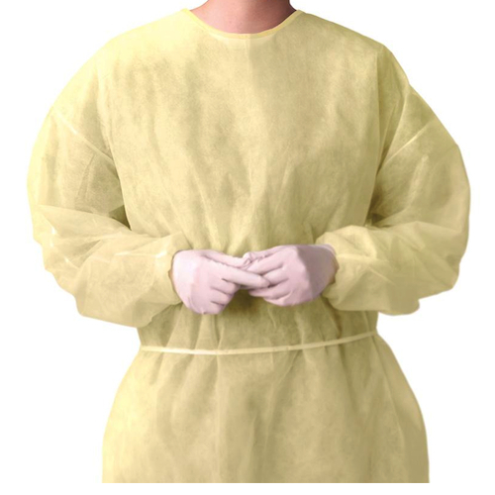
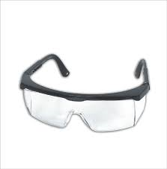
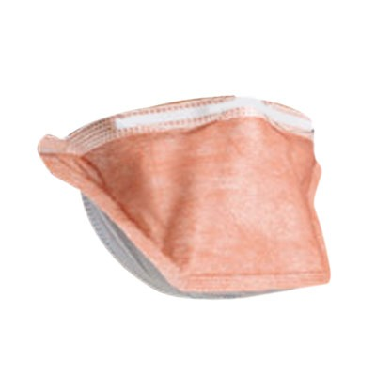
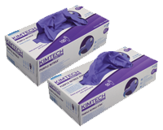
How do we make you safe?
Notes:
Gowns
Must be made of an impermeable material
A closed front
Long sleeves
Elasticised or knitted cuff at the wrist
Seams should be double stitched
Can be reused by the same staff member for the duration of the shift. Hang on a designated hook with the inside of the gown facing outwards
Protective Eyewear
Must be optically clear
Close fitted
Shielded at the sides
Staff that have prescription eyewear must wear disposable protective eyewear or a disposable visor over their prescription eyewear
Respiratory Protective Eyewear
A particulate respirator P2/N95, single person use
Mask can be reused for the entire shift, needs to be clearly marked with the staff members name, and discarded along with the gown at the end of the shift or if it becomes contaminated
Eyewear to be cleaned with warm soapy water and a disposable cloth, allowed to air dry
Gloves
Long enough to cover elasticised cuff of gown
Purple nitrile gloves (or in operating suite, double sterile gloves)
DON’T FORGET CLOSED IN SHOES
Shoe or boot style with fully enclosed toes heel and foo, non-perforated uppers and slip resistant sole

Slide 21
How do we keep everybody safe?
The Cytotoxic Drug Precautions Alert
Available on through Stream Solutions (HNE014000)
Escorting our patients between departments
Provide patient and carer education
Intensive training of staff
Accreditation through Cytotoxic education program, competency assessment
Reassessment of IV competency every 2 years to maintain accreditation
Notes:
Why is it important that patient require a nurse escort? What would you take with you? (2)
Information can include written and verbal information, the pharmacist may be a good resource for this. (3)
Precautions
Administration of the drug in the home environment
Side effects
How to manage body waste
Currently being reviewed with the aim of producing a formal document that will allow this information to be given to the carer and patient

Slide 22
Hand Hygiene
The 5 moments of hand hygiene need to be observed at all times.
At each moment water and hand soap need to be used when managing cytotoxics
Alcohol based hand washing preparations DO NOT eliminate chemical contamination
Notes:
What are the five moments of hand hygiene?
Before touching a patient
Before a procedure
After a procedure or body fluid exposure risk
After touching a patient
After touching a patients surroundings

Slide 23
Material Safety Data Sheets
Is a document that describes the chemical and physical properties of a material
Provides advice on safe handling and use
Recognised source of information
Developed for chemicals or materials that are considered hazardous
Accessed through the ChemAlert portal https://chemalert.rmt.com.au/nswhealth/index/index.do

Slide 24
Staff Surveillance
Notes:
The other way we keep you safe is through staff surveillance

Slide 25
Staff Surveillance
All individuals involved in the reconstitution, administration, storage , transportation and disposal of waste require staff surveillance by staff health
Baseline bloods
FBC, ESR, UEC, Liver Function Tests, Folate, Vitamin B12 levels
Repeated on an annual basis
Staff log
Notes:
Is offered to assist in the identification of adverse health outcomes related to potential exposure to cytotoxic medication or related waste (1)
Health monitoring may include pathology testing, urine screening, or physical examination (if clinically indicated) there is no single test to detect the presence of all cytotoxic medication(1)
Blood test results will be provided by the staff health to the employee (1)
Performed at baseline, then annually unless assessment of risk requires more frequent monitoring (2/3). Also performed at separation from employer
As well as the blood test, it is also required that staff complete a questionnaire dealing with the past and present exposure to cytotoxic drugs, past and current medical history
Currently these records are kept for a minimum of 75 years after the last action completed then destroyed.
It is important that you keep your own personal staff log, on termination of employment the employee will receive a written statement outlining the substances handled, period of potential of exposure, details of how and where the records can be obtained, and a recommendation on period of health checks

Slide 26
Cyclophosphamide
Recognised as a notifiable carcinogenic substance under the OHS Regulation
Toxic
When coverted….very similar to Sulphur Mustard (Mustard Gas) used as a chemical warfare agent
Vesicant
Notes:
Serious damage to health if prolonged exposure through inhalation and skin contact, potentially harm to an unborn child, alterations in fertility and CANCER
Sufficient epidemiological data to establish a causal association between exposure to the substance/material and cancer
Converted to an active alkylating metabolite.
Vesicant=tissue death

Slide 27
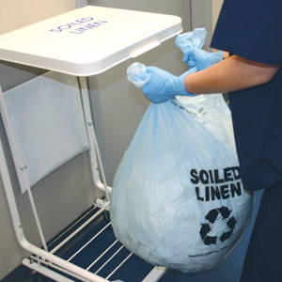
Management of Linen

Slide 28
Heavy Contamination
Manage heavily contaminated linen as a spill
Attach purple Cytotoxic waste bag to linen skip
Apply PPE
Fold linen to encapsulate & reduce aerolisation
Place directly into purple cytotoxic bag
Discard outer gloves into purple bag and tie off
Place purple cytotoxic bag in cytotoxic waste bin for collection
Notes:
Observe safe manual handling filling bag only to half full (4)

Slide 29
Light Contamination
Considered less than 5mls
Apply PPE
Fold linen to encapsulate &reduce aerolisation
Place linen directly into the linen skip
Tie bag off immediately
Place in linen collection area for collection and laundering
If unsure of volume of contamination follow the heavily soiled procedure

Slide 30
Management of Body Waste

Slide 31
Cytotoxic Waste Bins

Slide 32
Managing of cytotoxic body fluids
Body fluids include, urine, faeces and vomitus and are considered contaminated up to 7 days from the LAST cytotoxic administration
Body fluids can be disposed of in the normal sewage system
Single room allocation with ensuite where possible. If using communal bathroom facilities, patients need to be instructed to perform a full single flush after use, and report any splashes to staff immediately.
Notes:
Think about the patient as a whole, what is the cognitive ability?, could you allow them in a four bed cubicle if there is a cognitive deficit?
The person needs to follow instructions

Slide 33
Managing of cytotoxic body fluids
Communicate with other staff about required precautions
Clinical Bedside Handover
The Cytotoxic Drug Precautions Alert
Wear your PPE
Use closed and heated pan devices
Closed urinary devices should be considered carefully, and on an individual basis to manage the incontinent patient receiving cytotoxic mediation
Delivery of a Cytotoxic medication is not a sufficient clinical reason for the insertion of an IDC

Slide 34
Monitoring Patients Output
Where urine or faeces collection is required (fluid balance chart, pathology, urine analysis) and patient able to use a toilet a urine hat must be used for collection.
Correctly label the urine hat with the patients name
Urine hats a single patient use only and must remain in the patients own toilet
If output requires measurement, the patient must be accommodated in as single room
Patient needs to inform staff when it has been used
Any specimens collected and forwarded for testing must be labelled “contaminated with cytotoxics”

Slide 35
Cleaning of the urine hat
Apply PPE
Empty contents into toilet and return urine hat into original position
Be sure to empty the contents in the direction away from you
Return the urine hat to the original position and perform a full single flush
Tilt the urine hat away from you and perform a second full flush before returning to normal position
Any splashes need to be cleansed with neutral detergent and a disposable cloth
Remember 5 moments of hand hygiene, soap and water is required with cytotoxics
Discard the urine hat in the cytotoxic waste bin when precaution time has ended or measurement is no longer required

Slide 36
Oral Administration

Slide 37
Oral Administration
Only to be administered by accredited staff
No touch technique to be performed
Tablets or capsules must not be manipulated
Independent double check
Dispose of medication cup in cytotoxic waste receptacle
Exposure from body fluid is considered very low due to the small amount of body fluid, short duration of exposure, low risk of significant ingestion/inhalation/absorption
Notes:
No crushing or cutting (3)
Record administration in personal log

Slide 38
Talk to your Patient
Utilise the pharmacist
Expected side effects
Method of administration
Precautions
Secure home storage
Disposal of waste
Linen Management
Notes:
Written and verbal information including appropriate precautions (1)

Slide 39
Topical Administration

Slide 40
Cream, Ointments & Eye drops
Any other presentations of Cytotoxic medications need to refer to Cytotoxic Parenteral Safety Precautions
Only to be administered by accredited staff
Cytotoxic waste and linen bins are available
Spill kit is accessible and in date

Slide 41
Creams & Ointments
Use PPE
Clean the area of application with normal saline to remove old medication and any surface contamination
Use a clean disposal spatula for each time the cream or ointment is accessed
Dispose spatulas/excess medication in cytotoxic waste bin
Record administration in personal log

Slide 42
Eye Drops
Do not shake the eye drop container
Swirl the container to mix it and tap the bottom of the container to prevent spitting on opening the container
Approach the eye from the outer side
Tilt head backwards, gently pull the lower lid down to form a pouch
Hold the eye dropper close to the lid without touching either the lid or lashes

Slide 43
Eye Drops
Instill one drop at a time –prevent flooding of the eye
Instruct the patient to close eyes and apply gentle pressure against the inner corner with sterile gauze for 1-2 minutes
If the patient is unable to apply pressure staff can apply pressure using purple nitrile gloves
Dispose of waste into cytotoxic waste bin
Staff log

Slide 44
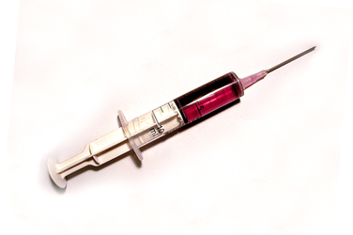
Subcutaneous & Intramuscular Injections

Slide 45
Subcutaneous & Intramuscular Injections
Dosage is made in controlled conditions.
Plastic backed sheet under injection site
Cleanse injection site with alcohol wipe
Place gauze around injection site
Connect the syringe and the needle over the kidney dish
At completion of the injection, sharp is to be disposed in cytotoxic sharps bin

Slide 46
Subcutaneous & Intramuscular Injections
Observe injection site foe inflammation, leakage or irritation
Apply adhesive dressing over injection site
Discard all other disposable cytotoxic equipment including PPE into cytotoxic waste bin
Goggles & Kidney dish to be cleansed with neutral detergent and dried
Record in staff log

Slide 47
Intravenous Administration
Establish if the cytotoxic medication has vesicant or irritant properties
Baseline vital observations to be attended and recorded
IVC must be less than 24hrs old
Not situated in the cubital fossa or above bony prominences
Opposite arm if blood has been collected in the previous 24hrs
Notes:
Extravasation kit (1)
A IVC greater than 24hrs old has an increases risk of extravasation (3)

Slide 48
Intravenous Administration
Spill kit – not expired
PPE
Baxter Pump and Baxter Infusion Lines
Y-connector
IV fluids/medication to be connected and disconnected on trolley with a plastic baked liner below eye level using gauze at connections in case of leakage
Line labelling
Notes:
Trolley in K1 (3)

Slide 49
Intravenous Administration
Explanation to patient
Observe injection site and patient at regular intervals
Adequate flush with appropriate IV fluid between medication and at completion of infusion
Dispose of equipment and PPE in appropriate cytotoxic receptacle
All pumps, trolleys trays and goggles are to be cleansed with neutral detergent post use.
Notes:
Alerting staff (1)

Slide 50
Management of an Extravasation

Slide 51
What is extravasation?
Leakage of pharmacological and physiological solutions from the intravascular to the interstitial space during an intravenous infusion
Some Cytotoxics have the potential to cause tissue necrosis
Extravasation Kit
Notes:
They are commonly known as vesicants, therefore they should not be administered IM or SC (2)

Slide 52
What should you do?
Prevention is the treatment of choice
Have an extravasation kit on hand (available from pharmacy)
Cytotoxic spill kit
Consider the risk for the patient prior to commencing the infusion
IVC needs to be positioned well, <24hours old and manage a fast flow of fluids (preload)
Stay with the patient and visualise the cannula continuously through the infusion process
Blood should be collected from the opposite arm if an infusion is in progress
Notes:
Risk
Patient needs to be able to communicate with the nurse
Not suitable for the confused/delirium
Consider the response from the elderly, debilitated, patients with fragile veins
Risk of extravasation increase the long the IVC is insitu
Vascular Disease
Fragile veins
IVC
Not over joints or bony prominences , or antecubital fossa of the arm
Same applies to CVAD

Slide 53
What if it occurs?
Stop administering the medication immediately
Keep the intravenous device in place until decision is made to administer antidote or not.
Attempt to withdraw 3-5ml of blood from the cannula
Inform the medical officer, and the patient
Mark the perimeter with a permanent marker and to take photograph
Notes:
This is the only occasion that blood should be removed via a cannula.

Slide 54
Nursing management
Apply hot and cold compresses depending on the extravasation
Apply lotions and creams according to the extravasation
Reassure patient
Complete an IMMS
Document in the medical record
Monitor site of extravasation
Organise medical follow up
Record administration in staff log book

Slide 55
Questions or comments

